Slide 1
Automated Testing Tools Selenium,JUnit, TestNG And Cypress

Slide 2
Introduction to automation testing
Manual testing is performed by a human sitting in front of a computer carefully executing the test steps. Automation Testing means using an automation tool to execute your test case suite.
The automation software can also enter test data into the system under test, compare expected and actual results and generate detailed test reports
Using a test automation tool, it's possible to record this test suite and re-play it as required.
The goal of Automation is to reduce the number of test cases to be run manually and not to eliminate manual testing altogether.

Slide 3
Why automation
Manual Testing of all workflows, all fields, and all negative scenarios is time and money consuming.
It is difficult to test for multilingual sites manually.
Automation does not require Human intervention.
Automation increases the speed of test execution.
Automation helps increase test coverage.
Manual Testing can become boring and hence error-prone.

Slide 4
Introduction to Selenium
Selenium is an open-source automation testing tool
Used for testing web applications
Supports multiple browsers(Chrome, Firefox, Edge, Safari) and platforms (Windows, Mac, Linux)
Widely used in software testing industry
Basic Selenium actions are click, type, and navigate

Slide 5
Why Selenium?
Automates repetitive testing tasks (Regression Testing)
Saves time and effort
Supports cross-browser testing
Integrates with CI/CD tools
Cost-effective (open source)

Slide 6
Using Selenium Web driver for automation testing
Step 1 – Download and install the Java Software Development Kit (JDK).
Step 2 – Download and install Eclipse IDE.
Step 3 - Download the Selenium Java client driver. Client driver is also available for other languages.
Step 4 - Configure Eclipse IDE with client driver.

Slide 7
Selenium Components
Selenium IDE – Record & playback
Selenium WebDriver – Core automation tool
Selenium Grid – Parallel testing
Each component serves different testing needs

Slide 8
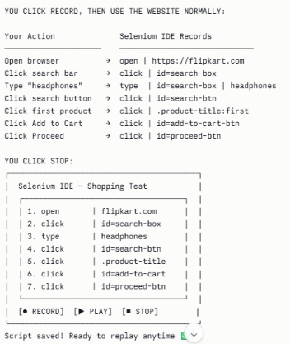
Selenium IDE
Selenium IDE is the simplest and most beginner-friendly component. It is a browser extension (like an add-on) that you install in Chrome or Firefox.
It works like a screen recorder, but instead of recording video, it records your actions on a website and converts them into a reusable test script.

Slide 9
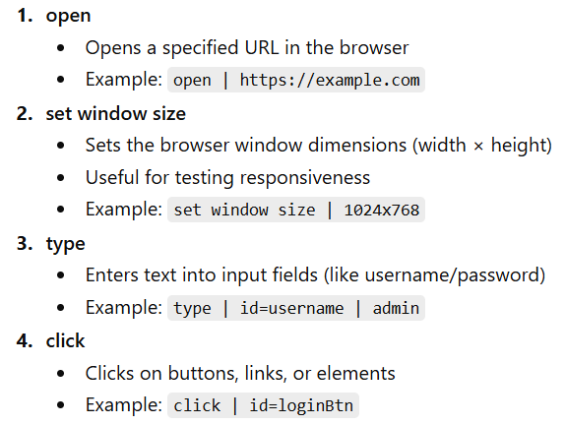
Selenium IDE Commands

Slide 10
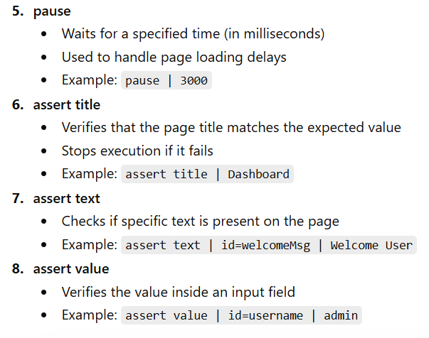
Continued…

Slide 11
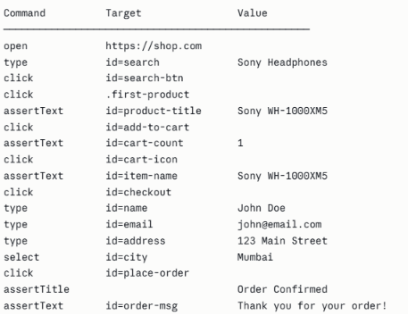
Example: Testing an E-commerce Checkout

Slide 12
Selenium IDE LIMITATIONS
Fragile- breaks when website changes
Only works in Chrome and Firefox
No parallel execution
Cannot handle complex logic such as :
- "If the item is out of stock, test the waitlist button instead"
- "Run this test 100 times with different data"
- "If step 3 fails, skip to step 7"
These require actual programming, which is where WebDriver comes in.

Slide 13
Selenium WebDriver
WebDriver is the heart of Selenium- the most powerful and widely used component. Unlike Selenium IDE (which records clicks), WebDriver requires you to write actual code that directly controls the browser.
It is a programming interface, a set of tools and commands, that lets your code talk directly to a browser and control it completely.

Slide 14
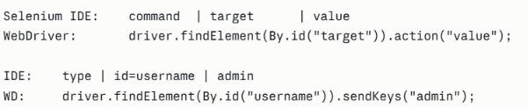
Selenium WebDriver COMMANDS
How to Read WebDriver Commands

Slide 15
Selenium WebDriver COMMANDS
Open:
Selenium IDE: open | https://example.com // Selenium WebDriver: driver.get("https://example.com");
Set window size:
Selenium IDE: set window size | 1024x768
Selenium WebDriver: driver.manage().window().setSize(new Dimension(1024, 768));

Slide 16
Selenium WebDriver COMMANDS
Type:
Selenium IDE: type | id=username | admin
Selenium WebDriver: driver.findElement(By.id("username")).sendKeys("admin");
Click :
Selenium IDE: click | id=loginBtn
Selenium WebDriver: driver.findElement(By.id("loginBtn")).click();

Slide 17
Selenium WebDriver COMMANDS
Pause:
Selenium IDE: pause | 2000
Selenium WebDriver: Thread.sleep(2000); // Wait 2 seconds
Assert title :
Selenium IDE: assert title | Dashboard
Selenium WebDriver: assertTrue(driver.getTitle().contains("Dashboard"));

Slide 18
Selenium WebDriver COMMANDS
Select (Dropdown) :
Selenium IDE: select | id=country | India
Selenium WebDriver:
Select dropdown = new Select(driver.findElement(By.id("country")));
dropdown.selectByVisibleText("India");
dropdown.selectByValue("IN");
dropdown.selectByIndex(0);

Slide 19
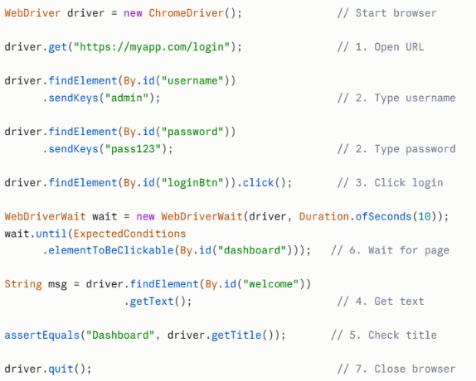
Selenium WebDriver COMMANDS Example

Slide 20
Selenium WebDriver LIMITATIONS
Requires programming knowledge
Slower setup- More configuration needed compared to Selenium IDE.
Tests can be brittle- If website structure changes, tests break and need code fixes.
No built-in reporting - Need extra libraries (ExtentReports, Allure) for nice reports.

Slide 21
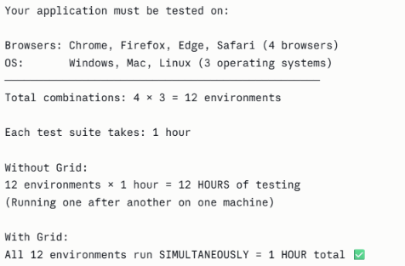
Selenium GRID
Selenium Grid is a tool that allows you to run multiple tests simultaneously across multiple browsers, operating systems, and machines- all at the same time.

Slide 22
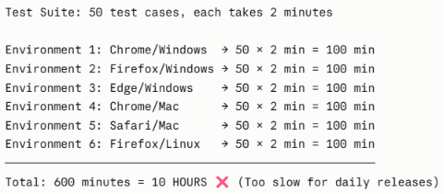
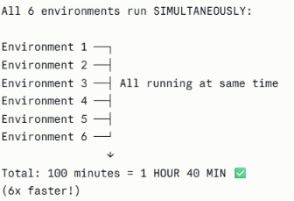
Selenium GRID Example
Scenario: A bank releases an update to their internet banking website. It must work perfectly on every browser and OS their customers use.
Without Grid:
With Grid:

Slide 23
Selenium Grid LIMITATIONS
Complex setup - Requires multiple machines, network configuration, maintenance.
Network dependency- If network between Hub and Node is slow, tests slow down.
Cloud-based Grids like BrowserStack and Sauce Labs give you hundreds of browser/OS combinations in the cloud- no setup, no maintenance, just connect and test.

Slide 24
Features of Selenium
Cross-Browser Testing → Executes tests on different browsers like Chrome, Firefox, and Edge.
Parallel Execution → Runs multiple tests simultaneously using Selenium Grid.

Slide 25
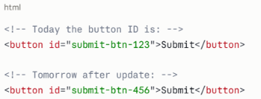
Features of Selenium
Dynamic Element Handling → Locates elements with changing attributes using XPath/CSS.
XPath: //button[contains(text(),'Submit')] This finds ANY button that says "Submit" — regardless of ID
Wait Mechanisms → Synchronizes test execution with page loading using waits.

Slide 26
Continued…
Screenshot Capture → Captures screenshots for debugging and reporting failures.
Alert Handling → Handles pop-ups and alerts (accept, dismiss, input).
Data-Driven Testing → Executes tests with multiple input datasets.
Framework Integration → Works with frameworks like TestNG and JUnit.
Headless Testing → Runs tests without opening the browser UI for faster execution.

Slide 27
Advantages & Limitations
Advantages:
Open source
Flexible and powerful
Large community support
Limitations:
Only web applications
Requires programming knowledge
No built-in reporting

Slide 28
Overview of JUnit
JUnit is one of the most widely used frameworks for unit testing Java applications. It allows developers to validate individual program components.
JUnit originated as a framework for automated Java unit testing and became a standard tool in test‑driven development environments.

Slide 29
Structure of a JUnit Test
JUnit tests contain annotated Java methods that validate expected outputs using assertion methods. Example :
import org.junit.jupiter.api.Test
import static org.junit.jupiter.api.Assertions.*;
@Test
void testAddition(){
int result = 5+3;
assertEquals(8,result);
}

Slide 30
JUnit Annotations
@Test identifies test methods.
@BeforeEach prepares environment before a test.
@AfterEach performs cleanup operations.
@BeforeAll executes once before all tests. @AfterAll executes once after test execution completes.

Slide 31
JUnit Assertions
Assertions validate expected results.
Common assertions include assertEquals, assertTrue, assertFalse, assertNull and assertNotNull.
@Test
void validateNumber(){
int number=10;
assertTrue(number>0);
}

Slide 32
Benefits and limitations of JUnit
Benefits
JUnit enables automated validation of code logic, supports regression testing and integrates with build tools like Maven.
JUnit is used to test business logic in enterprise Java systems such as banking software and financial applications.
Limitations
JUnit is primarily focused on unit testing and does not provide advanced features such as test grouping.

Slide 33
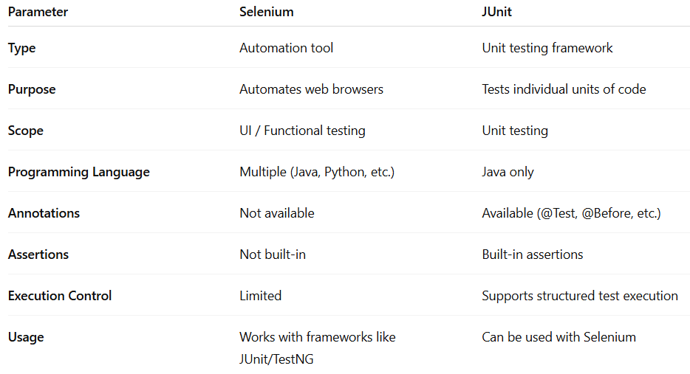
Comparison of selenium and JUnit

Slide 34
Overview And Motivation For Tool TestNG
TestNG (Test Next Generation) is an advanced Java testing framework inspired by JUnit and designed for scalable automated testing.
Large applications require features like grouping, dependency management and parallel execution which are supported by TestNG.
TestNG supports annotations, parallel execution, data driven testing, grouping and dependency based test execution.
TestNG uses annotations in Java classes combined with XML configuration files to define test execution structure.

Slide 35
Basic TestNG Example
import org.testng.annotations.*;
import org.testng.Assert;
public class CalculatorTest {
Calculator calc;
@BeforeMethod
void setup() {
calc = new Calculator();
}
@Test
void testAdd() {
int result = calc.add(5, 3);
Assert.assertEquals(result, 8);
}
@Test
void testSubtract() {
int result = calc.subtract(10, 4);
Assert.assertEquals(result, 6);
}
@AfterMethod
void teardown() {
System.out.println("Test done.");
}
}

Slide 36
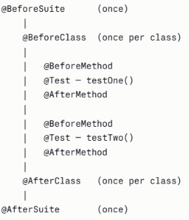
Important TestNG Annotations
@Test identifies test methods.
@BeforeMethod and @AfterMethod control setup and cleanup tasks.
@BeforeSuite and @AfterSuite that runs once before and after an entire test Suite.
@BeforeClass and @AfterClass runs once before and after a class

Slide 37
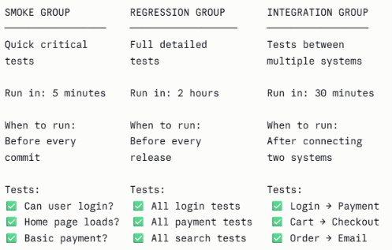
Important TestNG Annotations
Test Grouping :
TestNG allows grouping of related test cases such as smoke tests, regression tests and integration tests.
@Test(groups="smoke")
public void loginTest(){ }

Slide 38


Test Dependencies
TestNG allows tests to depend on other tests which is useful for validating sequential workflows.
@Test
public void login(){ }
@Test(dependsOnMethods="login")
public void dashboardAccess(){ }

Slide 39
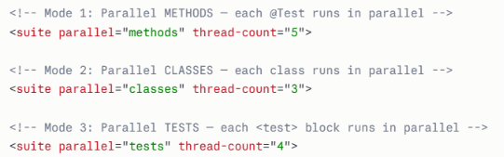
Other features of TestNG
TestNG enables execution of multiple tests simultaneously which reduces overall testing time.
TestNG supports parameterized tests to run the same test with multiple input values.

Slide 40
Parameterized Example
@Parameters({"username","password"})
@Test
public void loginTest(String u,String p){ }
Enterprise applications use TestNG to automate complex testing workflows and large regression suites.

Slide 41
Overview of Cypress
Cypress is a modern JavaScript based end to end testing framework used primarily for web applications.
Cypress is used for automated testing of web applications, especially to test how a user interacts with a website from start to finish.
Advantages
Cypress simplifies UI automation testing and provides excellent debugging support for front end developers.

Slide 42
Example of Visiting a Website
This test checks whether a website opens successfully.
describe('Website Test', () => { it('Visit homepage', () => { cy.visit('https://example.com') }) })
describe() → defines a test suite
it() → defines a test case
cy.visit() → opens the website in the browser

Slide 43
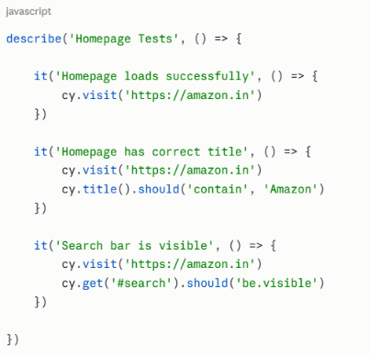
Example of Visiting a Website

Slide 44
Cypress Commands
In Cypress, the following commands are commonly used to interact with web elements:
cy.visit() – Opens a specified URL in the browser to start testing a webpage. cy.visit('https://flipkart.com')
cy.get() – Selects a web element on the page using a selector such as an ID, class, or tag. cy.get('#username') // Find by ID (# means ID)
cy.click() – Simulates a user clicking on a selected button, link, or element. cy.get('#login-btn').click() // Click login button
cy.type() – Enters text into an input field such as a username or password box. cy.get('#username').type('john@email.com')

Slide 45
Form Testing Example
cy.get('#username').type('admin')
cy.get('#password').type('1234')
cy.get('#login').click()

Slide 46
Real-World Applications of Cypress
Cypress is commonly used in:
E-commerce websites – testing checkout and cart flow
Online banking systems – testing login and transactions
Web dashboards – verifying UI functionality
SaaS platforms – validating user workflows

Slide 47
Comparison: JUnit vs TestNG vs Cypress
JUnit focuses on Java unit testing.
TestNG extends JUnit with advanced features.
Cypress focuses on web application end to end testing.

Slide 48
When to Use Junit, TestNG and Cypress
JUnit is best suited for validating individual Java methods and classes during early development.
TestNG is ideal for large automation frameworks requiring grouping, dependencies and parallel testing.
Cypress is best suited for modern web applications where UI workflows must be validated automatically.

Slide 49
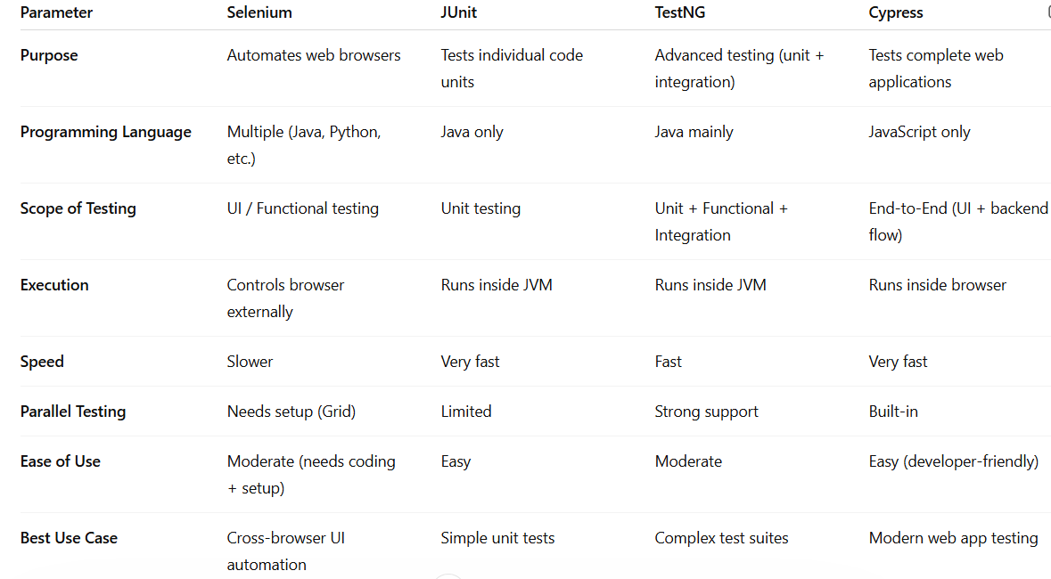
Comparison of testing tools

Slide 50
Summary
Selenium is used for testing web applications
JUnit, TestNG and Cypress represent different layers of automated testing covering unit testing, advanced automation and web UI testing.

